Slide 1
10-7
Command-line arguments
Saving the output of a simulation (to file)
Reading data in from file

Slide 2
Problem: run the Ranger 7 code many times, with many different initial velocities.
How do you change v0 if you don’t want to change the code (cat+keyboard problem)?
Suppress most information, only care about trajectory (t,x,v dots) and time of flight

Slide 3
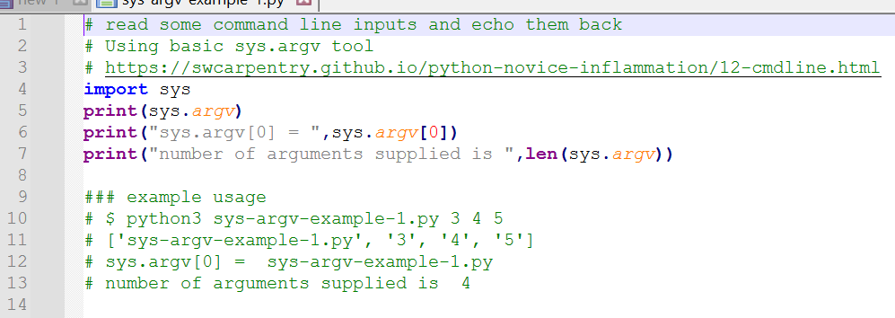
Command line arguments are in sys.argv

Slide 4
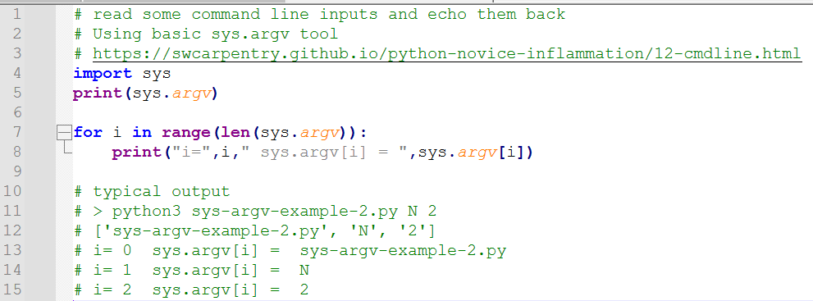
You can iterate through argv

Slide 5
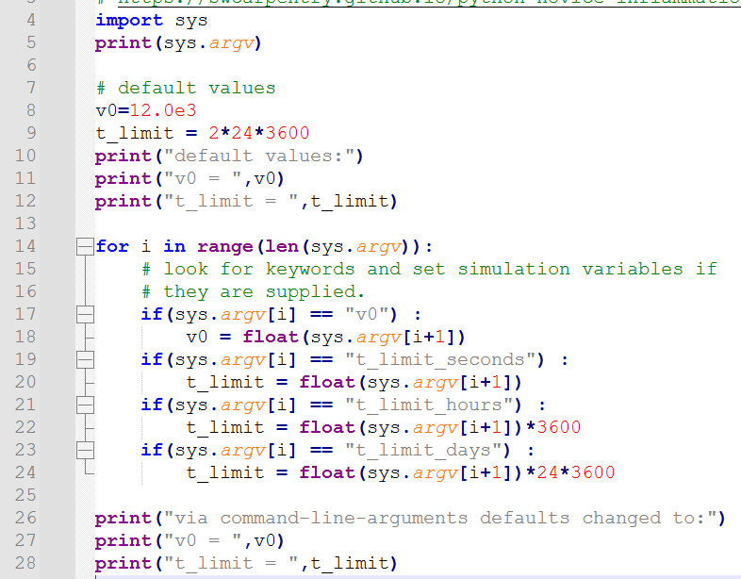
You can change from defaults by iterating w/ a set of if-blocks

Slide 6
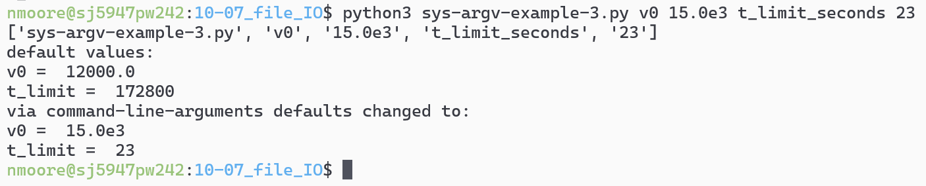

Slide 7
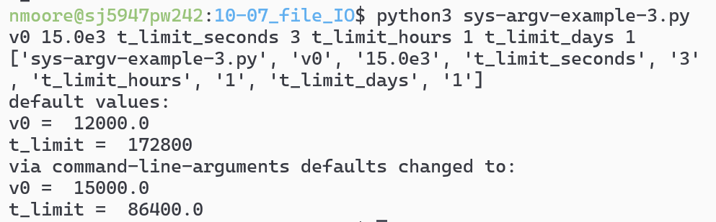
Is this a “good” parser? NO!

Slide 8
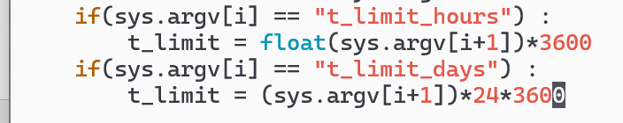
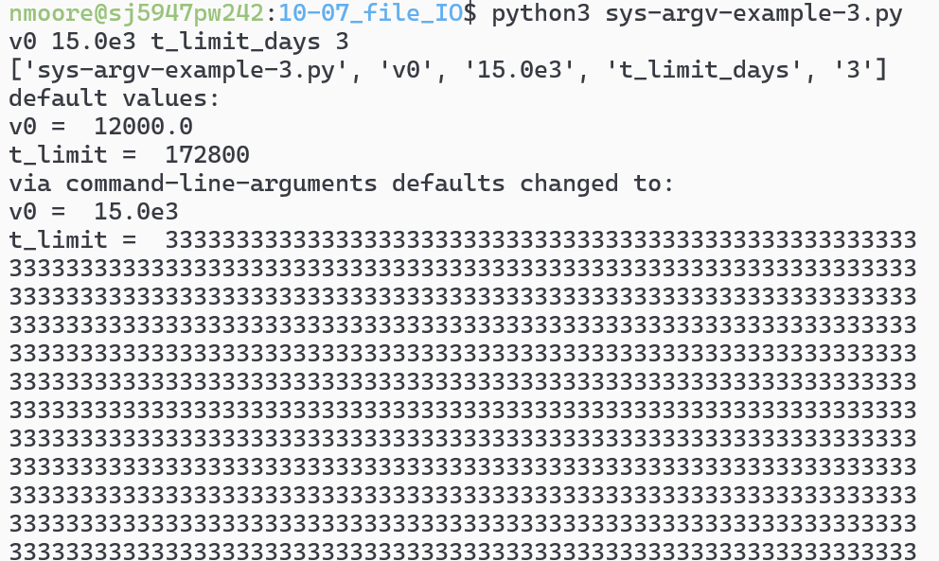
Do I really have to call “float” on the inputs? YES!

Slide 9

How do I fold this into the Ranger 7 code?
Treat the previous solver like it is under glass
After defining default t_limit and v0 values,
Then parse the inputs (if any).
Suppress all plots and prints (or produce them with an argv switch)
Print out time of flight and maybe trajectory

Slide 10
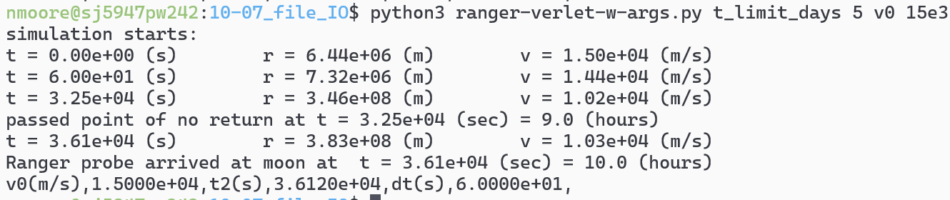
Look at code file. Then,
Run the program many times and collect the results? How?

Slide 11
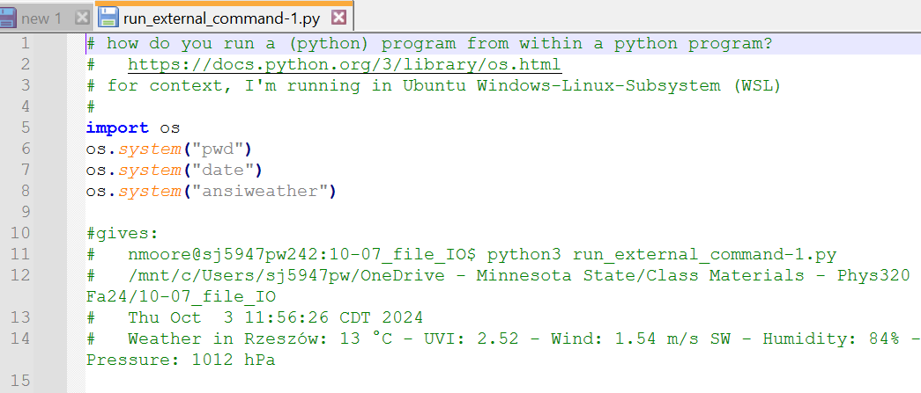
Run a program, from a python program?

Slide 12
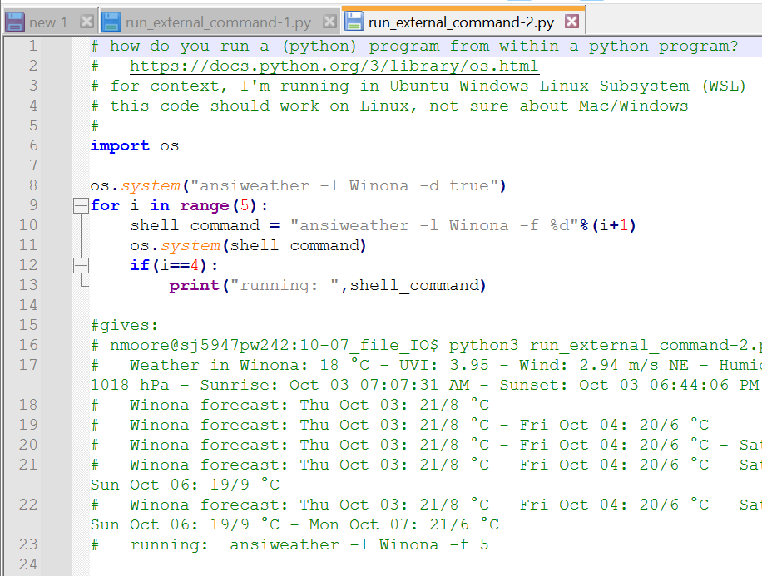
Run a program, from a python program?

Slide 13
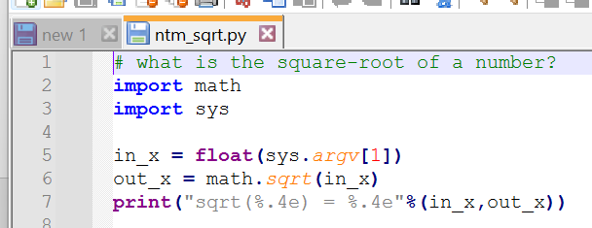
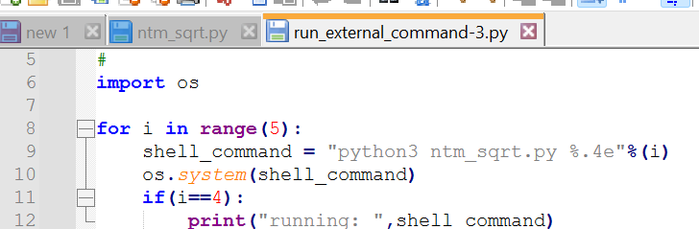
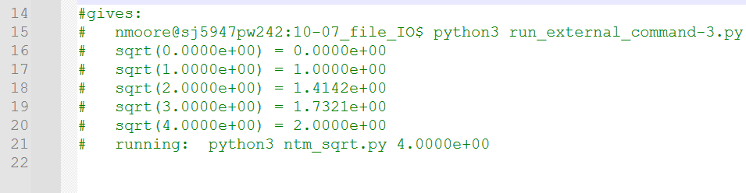
Run a python program, from a python program?

Slide 14
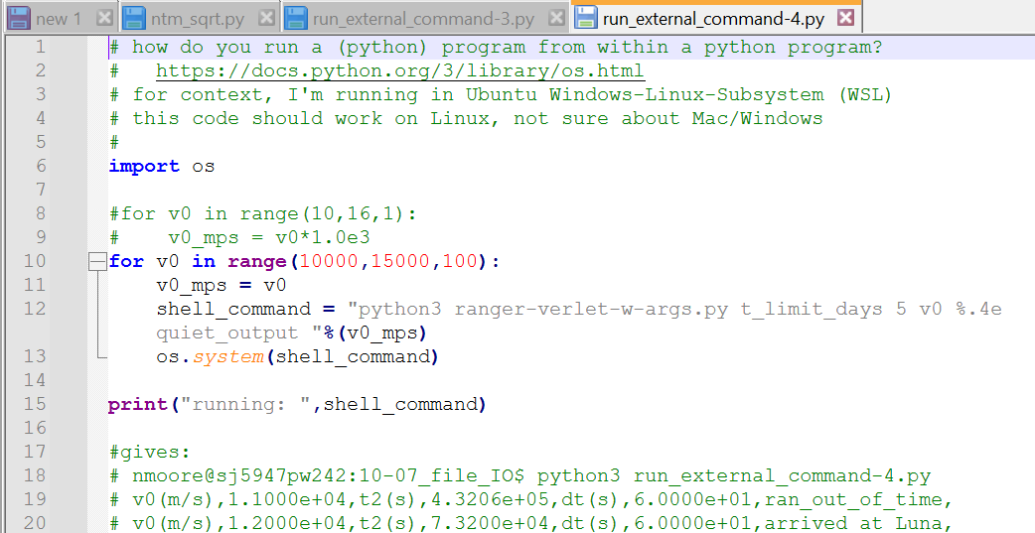
Reminder of our goal: Run the program many times and collect the results? How?

Slide 15
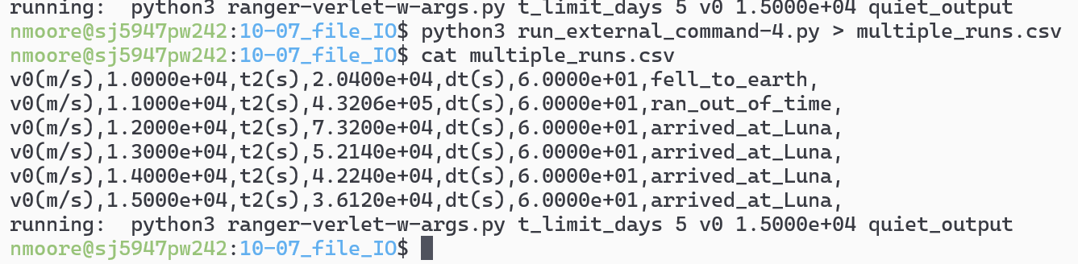
Run the program many times and send the results to a csv file

Slide 16
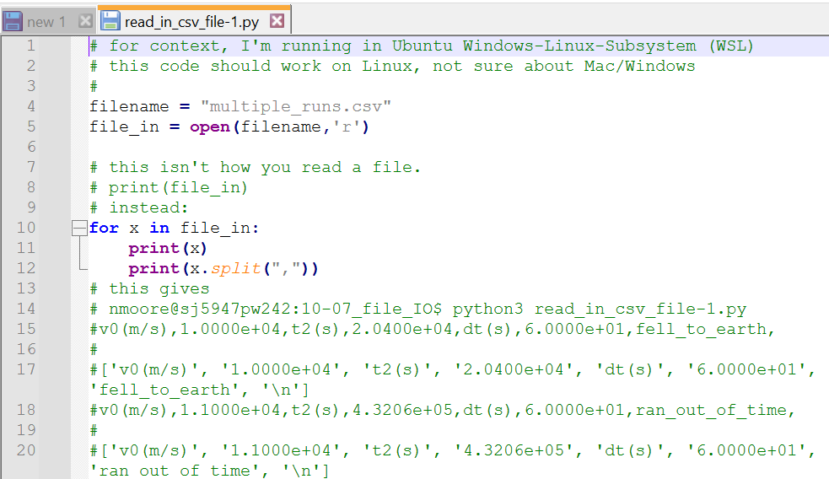
Open the csv file for analysis and plotting

Slide 17
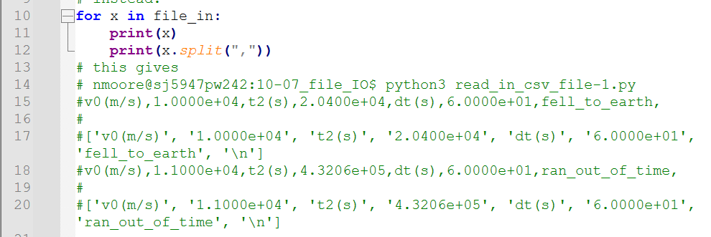
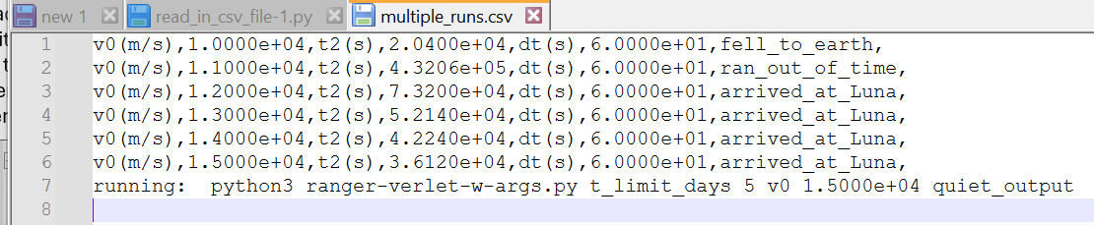
For each line in the file:
Read the line in.
Split via comma.
For the data you want to keep, append it to an array.
After reading in all the data (but not the first/last line?) close the file.
Then turn your lists into numpy arrays for plotting

Slide 18
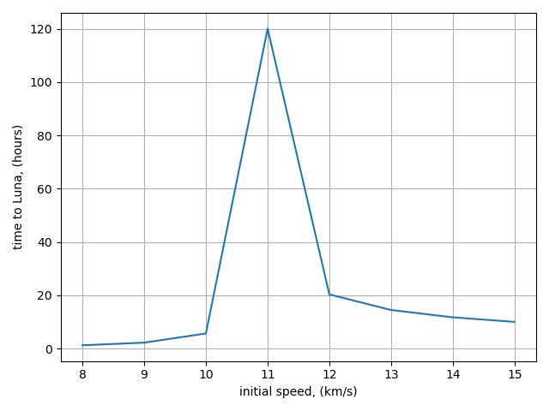
What’s wrong with this graph?

Slide 19
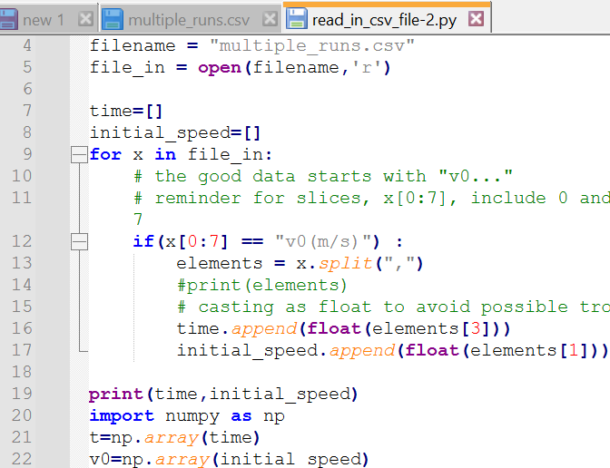
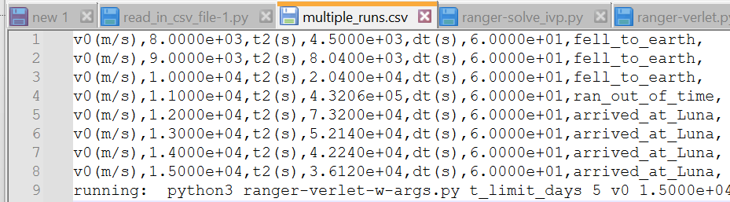
What’s wrong, and how can we fix it?

Slide 20
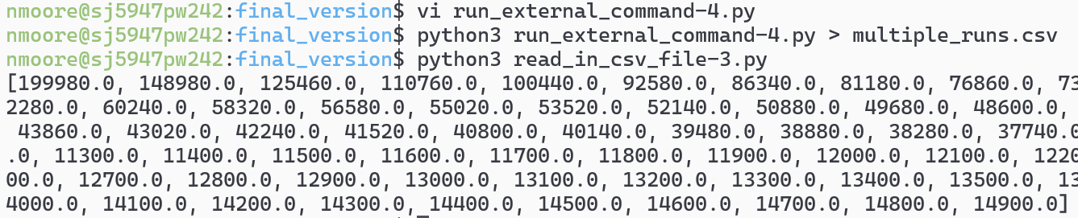
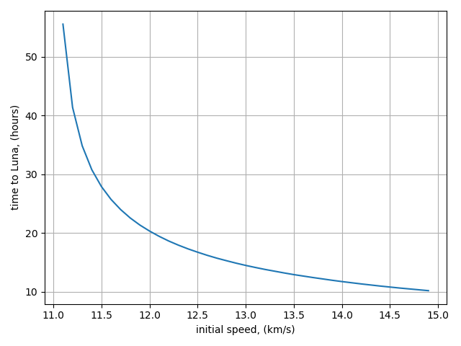
Putting it all together

